Slide 1
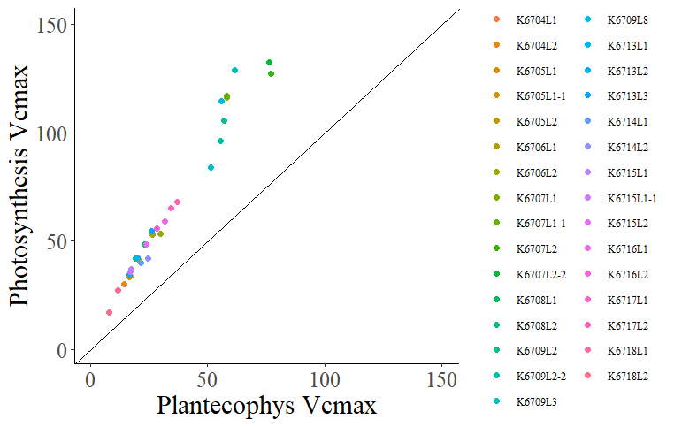
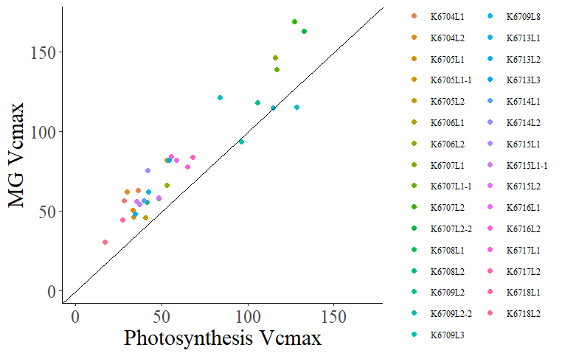
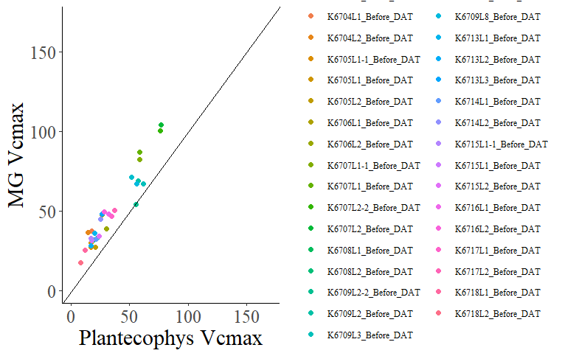
Vcmax
Plantecophys did not fit K6702L1 for some reason

Slide 2
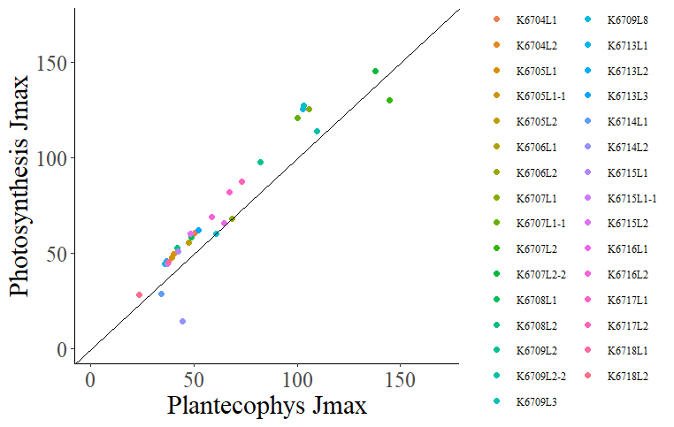
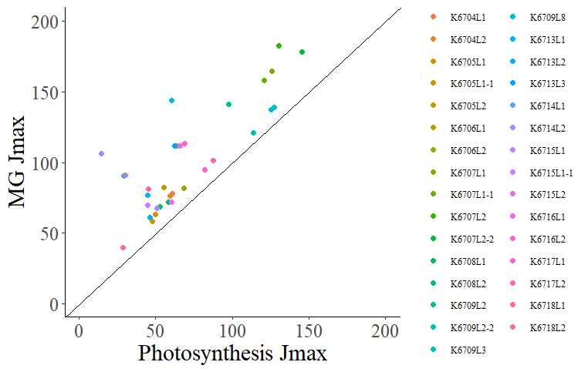
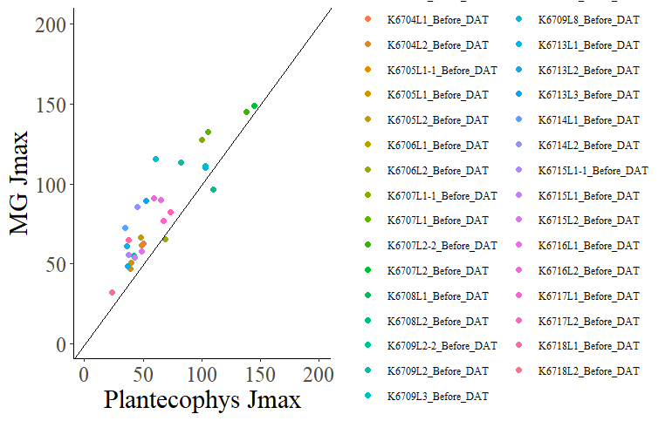
Jmax
Notes:
# Note: K6706L1 jmax for plantecophys is 800000, and is not included in the graph

Slide 3
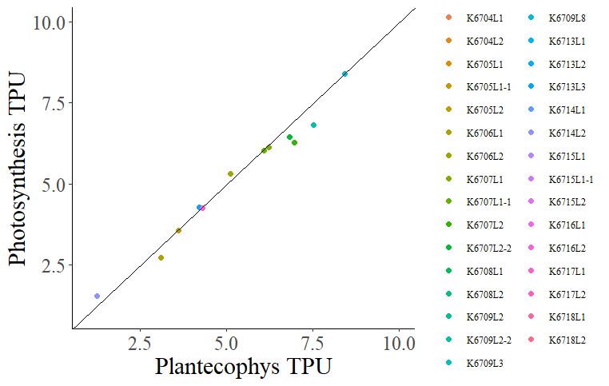
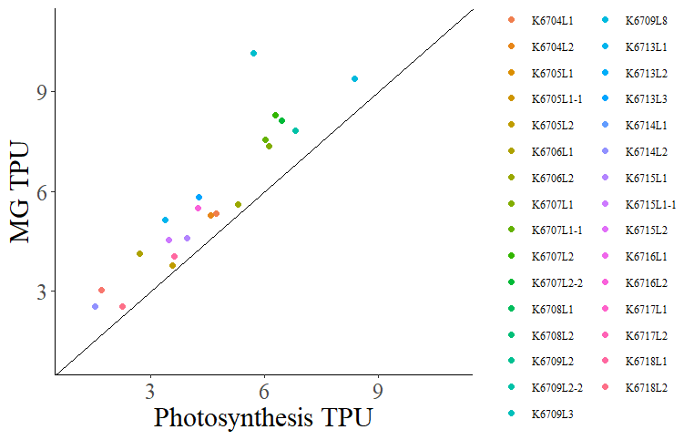
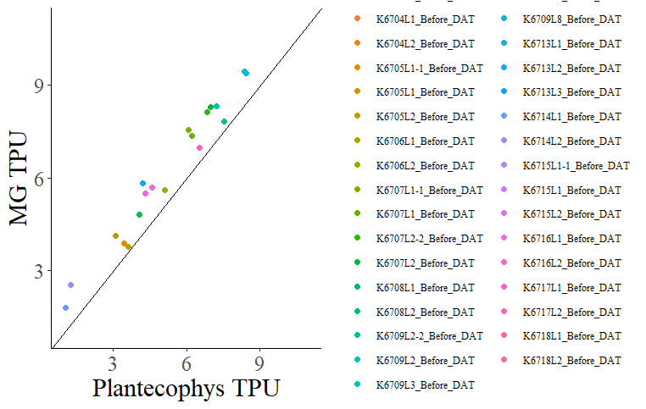
TPU
They did not all fit TPU for the same curves, or the same number of curves
Notes:
# Note: TPU for several of the curves via the photosynthesis package are at 1000 (likely meaning it
# wasn't fit). These are not included in the chart

